Slide 1
Newton-Raphson Method
A.3

Slide 2




Equation Solving
Given an approximate location (initial value)
find a single real root
A
Root
Finding
non-linear
Single variable
Open
Methods
Brackting
Methods
Iterative
False-
position
Newton-
Rapson
Bisection
Secant

Slide 3
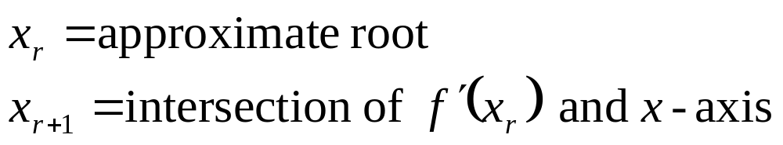
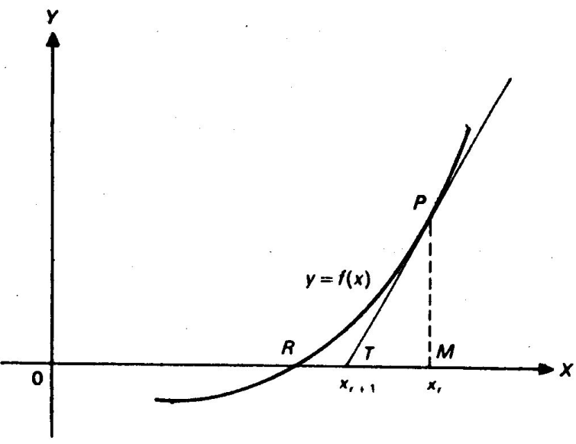
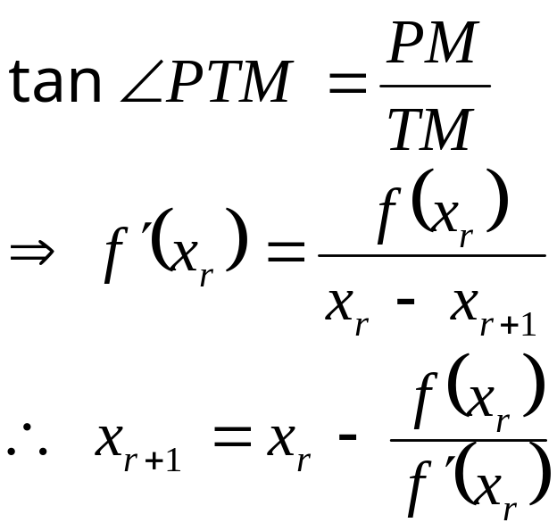
Method
We want to solve f(x)=0 near x_{r}

Slide 4
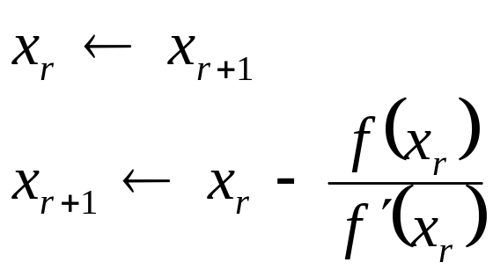
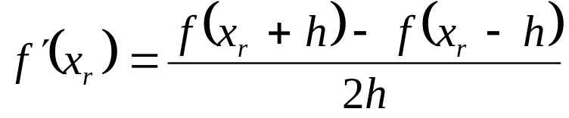
Algorithm
x_{r+1} ← initial guess value
do {
} while (⎪ x_{r+1} − x_{r} ⎪> Q)
We can compute the derivative numerically as follows:

Slide 5
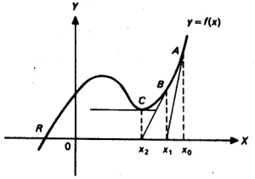
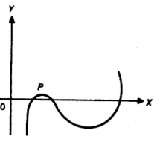
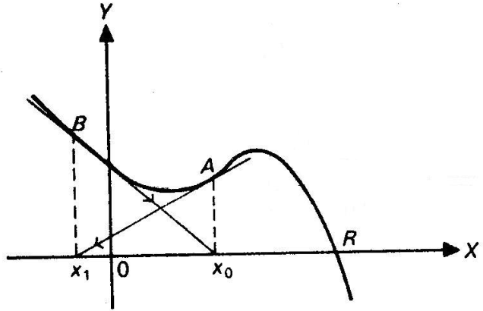
Limitations
f′(x_{r+1})=0, local minima.
f′(x_{r+1})≈0 , occurs when two roots are very close.
x_{r} and x_{r+1} recurs

Slide 6
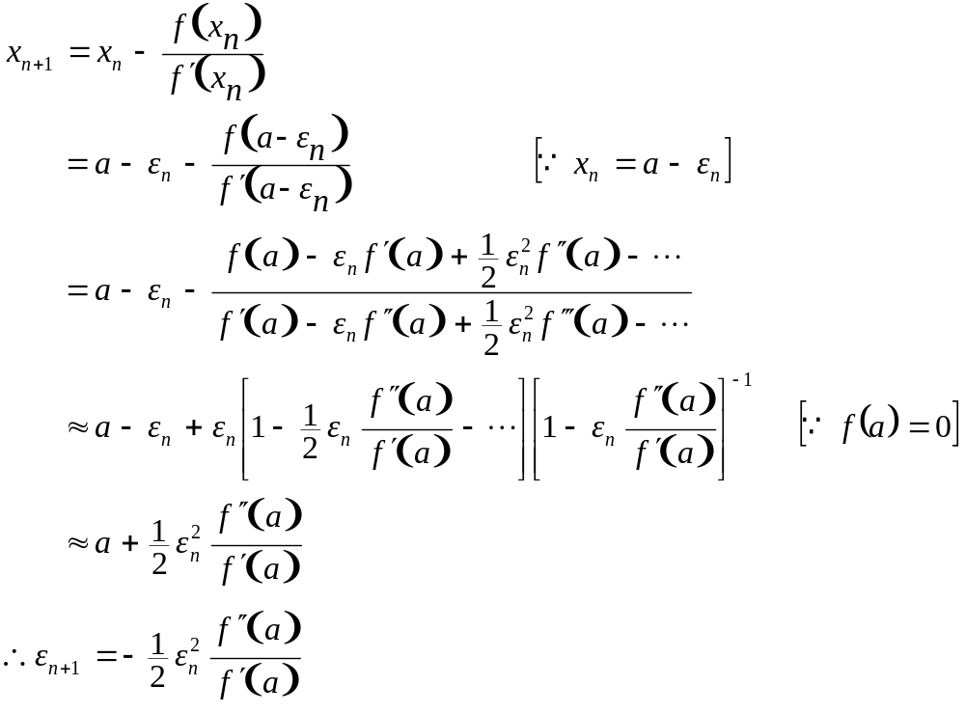
Convergence
Second order convergence

Slide 7
Example
_______________________
x^2-5x+4=0
0 Xr=5.000 Xr+1=4.200
1 Xr=4.200 Xr+1=4.012
2 Xr=4.012 Xr+1=4.000
3 Xr=4.000 Xr+1=4.000
3 Xr=4.000 Xr+1=4.000
_______________________
e^(-x)-x=0
0 Xr=1.000 Xr+1=0.538
1 Xr=0.538 Xr+1=0.567
2 Xr=0.567 Xr+1=0.567
2 Xr=0.567 Xr+1=0.567
_______________________
xsin(x*x)-2cos(x)
0 Xr=1.000 Xr+1=0.538
1 Xr=0.538 Xr+1=0.567
2 Xr=0.567 Xr+1=0.567
2 Xr=0.567 Xr+1=0.567

Slide 8
Secant Method
A.4
April 5, 2009

Slide 9
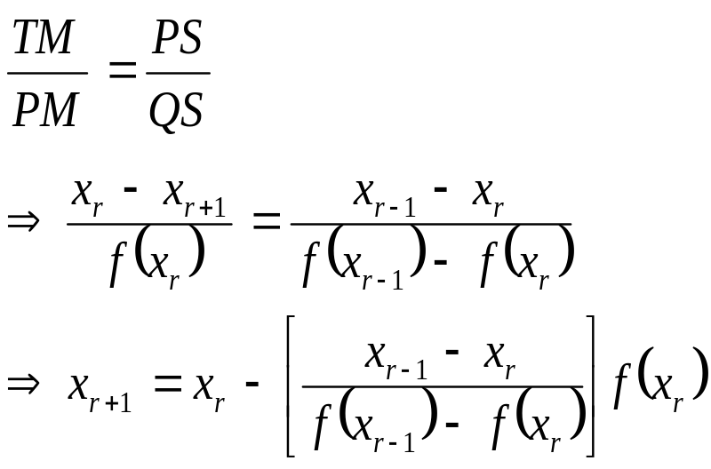
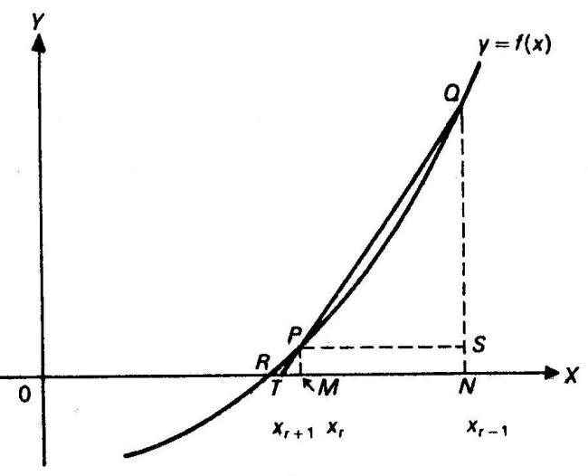
Concept
Newton-Raphson method needs to compute f′(x)
  It may be analytically complicated, or
  Numerical evaluation may be time consuming
Tangent is replaced with chord ⇒ lower convergence rate

Slide 10
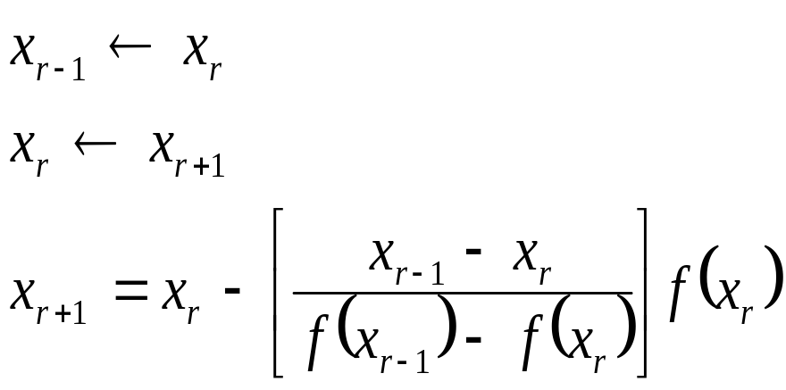
Algorithm
x_{r} ← initial guess value
x_{r+1} ← initial guess value
do {
} while (⎪ x_{r+1} − x_{r} ⎪> Q)

Slide 11
False Position Method
A.4
April 5, 2009

Slide 12
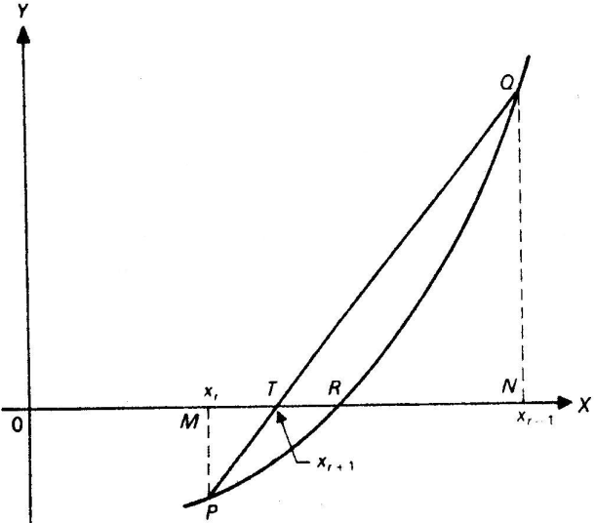
Concept
Same as Secant method, except that the root is always between x_{r} and x_{r-1} i.e., f(x_{r})*f(x_{r-1}) < 0
Convergence is lower than Newton-Raphson method
Guarantees success

Slide 13
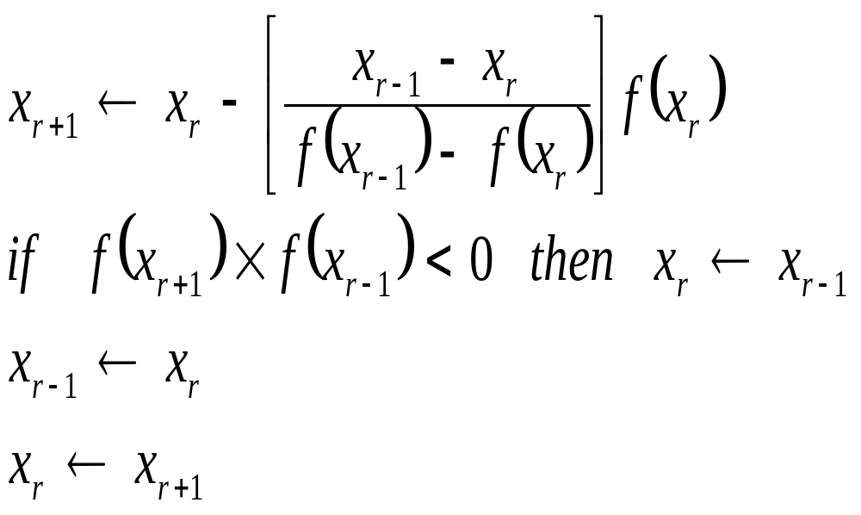
Algorithm
Choose x_{r} and x_{r-1} such that f(x_{r})*f(x_{r-1}) < 0
do {
} while (⎪ x_{r+1} − x_{r} ⎪> Q)

